Slide 1
Development of Thulium and Holmium Fibre Sources
OSA Webinar
Dr. Nikita Simakov
Defence Science Technology Group, Edinburgh, SA 5111, Australia.

Slide 2
Acknowledgement
Colleagues, friends, supervisors and students
  DST Group
  Nufern, (Coherent|Nufern)
  IPAS and School of Chemistry and Physics, The University of Adelaide,
  Optoelectronic Research Centre, Southampton University
  Naval Research Laboratories
  Air Force Research Laboratories

Slide 3
Contents
This is aimed for students and supervisors who have a requirement to build a source in the 1.7 – 2.2 µm region
Thulium and Holmium silica spectroscopy
Typical operating regions
Enabling components
Examples of projects that have relied on this technology

Slide 4
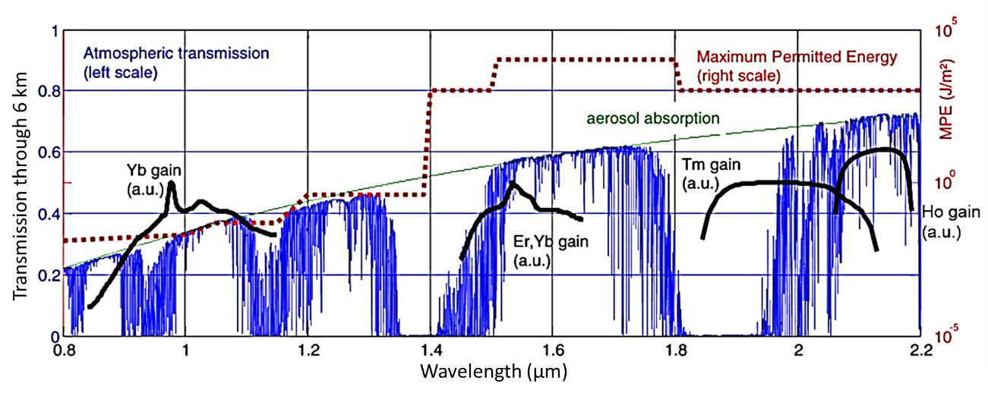
Remote sensing
J.-P. Cariou, B. Augere, and M. Valla, "Laser source requirements for coherent lidars based on fiber technology," Comptes Rendus Phys. 7, 213–223 (2006).
G. Canat, W. Renard, E. Lucas, L. Lombard, J. Le Gouët, A. Durécu, P. Bourdon, S. Bordais, and Y. Jaouën, "Eyesafe high peak power pulsed fiber lasers limited by fiber nonlinearity," Opt. Fiber Technol. 20, 678–687 (2014).

Slide 5
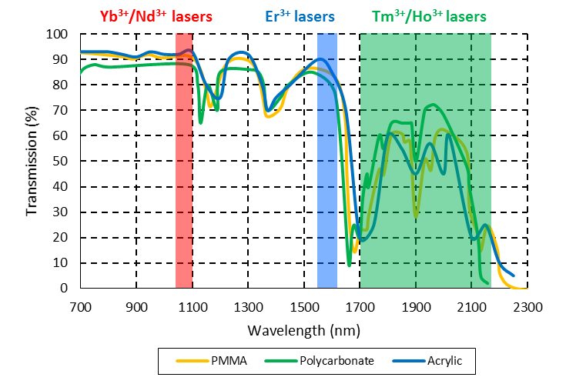
Material absorption
ALTUGLAS, "Acrylic Sheet Plexiglas: Optical and Transmission Characteristics," (2000).

Slide 6
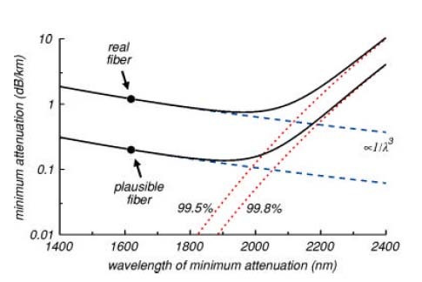
Hollow core optical fibres
Low loss window at 2 µm
P. J. Roberts, F. Couny, H. Sabert, B. J. Mangan, D. P. Williams, L. Farr, M. W. Mason, A. Tomlinson, T. A. Birks, J. C. Knight, and P. St.J. Russell, "Ultimate low loss of hollow-core photonic crystal fibres," Opt. Express 13, 236-244 (2005)

Slide 7
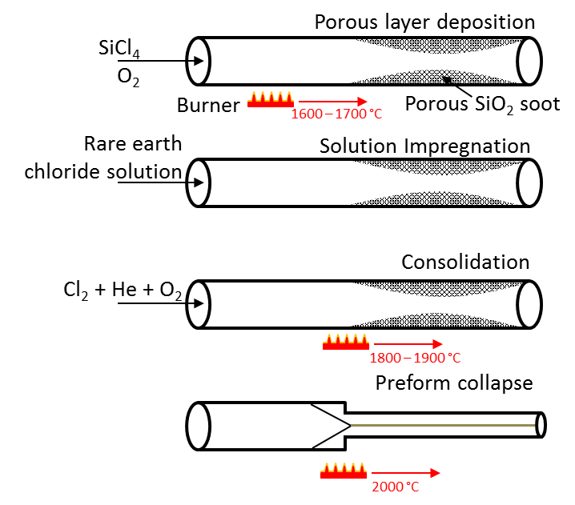
Active fibre fabrication

Slide 8
Composition
Material | IR transmission edge vs SiO₂ | Host properties | Refractive index vs SiO₂
Al₂O₃ | No effect | Enhances solubility Reduces phonon energy, improves lifetime | Increase
GeO₂ | Slight improvement | Photosensitive | Increase
F | No effect | - | Decrease
P₂O₅ | Worse With hydroxyl has additional absorption features | Enhances solubility Increases local phonon energy, Quenches lifetime * | Increase
B₂O₃ | Much worse | Quenches lifetime * Increases local phonon energy, Commonly used for stress rods | Decrease
Ho₂O₃ | Unknown | Lasing ion Enhances photosensitivity with GeO₂ | Increase
*C. B. Layne, W. H. Lowdermilk, and M. J. Weber, "Multiphonon relaxation of rare-earth ions in oxide glasses," Phys. Rev. B 16, 10–20 (1977).

Slide 9
Single mode fibres at 2 µm
Longer wavelength
  Single mode cut off at larger core diameter or larger numerical aperture
  V = 2πr/λ x NA
  Single mode for V < 2.405
    SMF-28 is very bend sensitive V ~ 1.8 at 2 µm
  ‘Nice’ single mode fibres will have increased core diameters or Numerical Apertures
  SM2000 or SM1950 (Thorlabs/Nufern) as an example

Slide 10
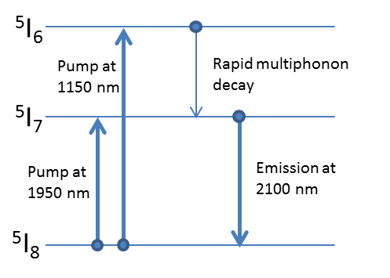
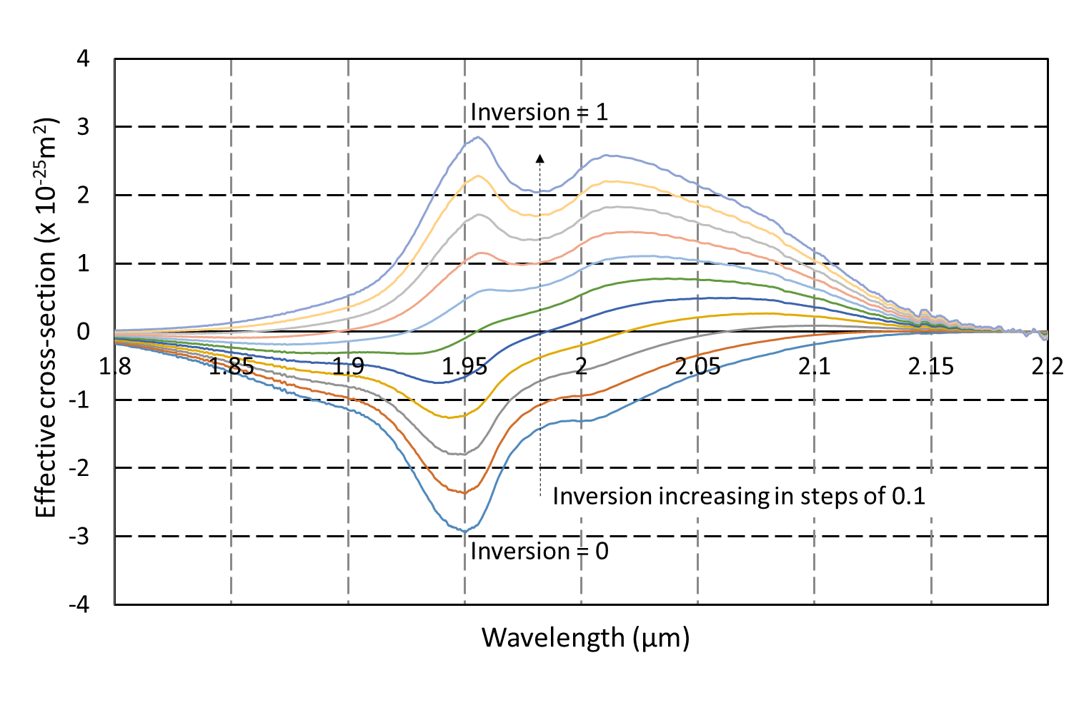
Holmium:silica spectroscopy
Pump | Quantum defect
1150 | 46%
1950 | 7%
S. R. Bowman, N. J. Condon, S. O. Connor, T. Ehrenreich, W. Kanxian, K. Farley, and S. Christensen, "Radiation Balanced Holmium Fiber Lasers," Proc. SPIE 7951, 795107 (2011).

Slide 11
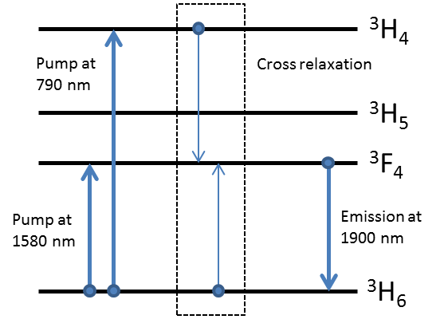
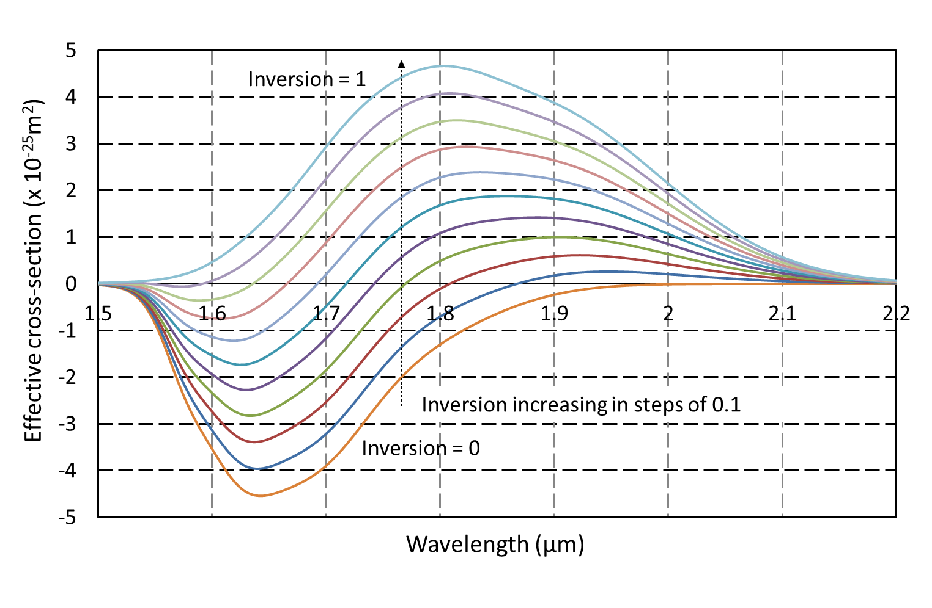
Thulium:silica spectroscopy
Pump | Quantum defect
790 | 60%
1550 | 23%
P. F. Moulton, G. A. Rines, E. V. Slobodtchikov, K. F. Wall, G. Frith, B. Samson, and A. L. G. Carter, "Tm-Doped Fiber Lasers: Fundamentals and Power Scaling," IEEE J. Sel. Top. Quantum Electron. 15, 85–92 (2009).

Slide 12
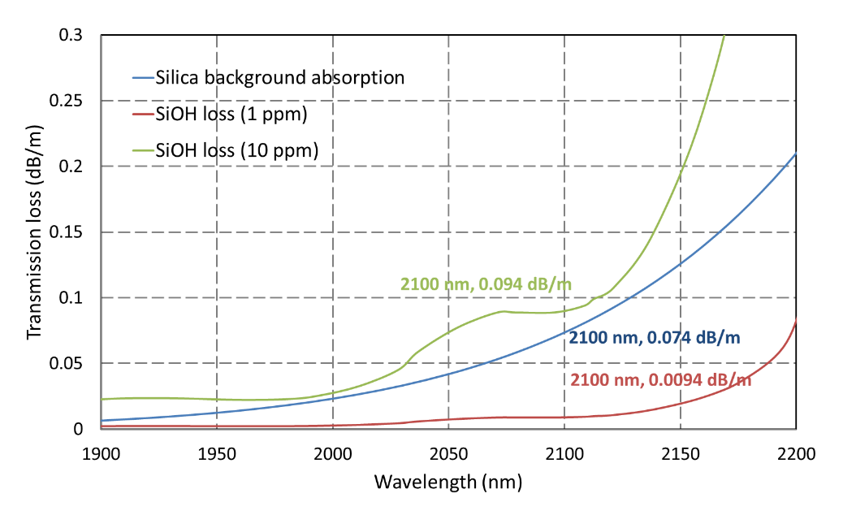
Fibre background losses
O. Humbach, H. Fabian, U. Grzesik, U. Haken, and W. Heitmann, "Analysis of OH absorption bands in synthetic silica," J. Non. Cryst. Solids 203, 19–26 (1996).

Slide 13
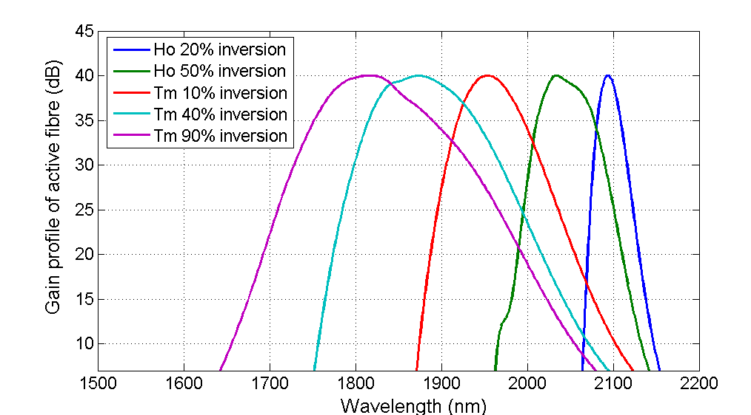
Theoretical operating regions

Slide 14
Experimental operating regions
TDFA (34 THz)
HDFA (8.3 THz)
Solid: Fibre laser pumped
Open: Diode pumped
Fitted Line: Gain
No Line: Noise Figure
7.
9.
3.
10.
4.
1.
2.
5.
6.
8.
Silica IR loss

Slide 15
Summary of amplifier characteristics
Gain medium | Pump source | Spectral filtering | Peak gain (dB) | Gain peak (nm) | 15 dB span (nm) | Δλ (nm) | Noise Figure (dB) | Ref. | Legend for Fig. 5.10
Thulium | EYDFL | Yes | 29 | 1690 | 1660–1710 | 50 | 6.5-12 | [16,17] | 1.
Thulium | Diode, 790 nm | Yes | 29 | 1760 | 1720–1800 | 80 | 9-15 | [16,17] | 2.
Thulium | EYDFL | Yes | 33 | 1760 | 1710-1800 | 90 | 9-15 | [16,17] | 3.
Thulium | Diode, 1550 nm | No | 35 | 1840 | 1740-1960 | 220 | 5-10 | [18,19] | 4.
Thulium | Diode, 1550 nm | No | 36 | 1900 | 1820–2030 | 210 | 5-10 | [18,19] | 5.
Thulium | Diode, 1550 nm | No | 33 | 1950 | 1890–2050 | 160 | 5-10 | [18,19] | 6.
Thulium | EYDFL | No | 42 | 1950 | 1910–2020 | 110 | 5-12 | [18,19] | 7.
Holmium | Diode, 1150 nm | No | 25 | 2040 | 2030–2100 | 70 | 5-7 | [15] | 8.
Holmium | TDFL | No | 41 | 2060 | 2050–2120 | 70 | 6-10 | [15] | 9.
Holmium | TDFL | Yes | 39 | 2090 | 2050–2150 | 100 | 8-14 | [15] | 10.

Slide 16
References for previous figure/table
15. N. Simakov, Z. Li, Y. Jung, J. M. O. Daniel, P. Barua, P. C. Shardlow, S. Liang, J. K. Sahu, A. Hemming, W. A. Clarkson, S.-U. Alam, and D. J. Richardson, "High gain holmium-doped fibre amplifiers," Opt. Express 24, 13946 (2016).
16. Z. Li, Y. Jung, J. M. O. Daniel, N. Simakov, M. Tokurakawa, P. C. Shardlow, D. Jain, J. K. Sahu, A. M. Heidt, W. A. Clarkson, S. U. Alam, and D. J. Richardson, "Exploiting the short wavelength gain of silica-based thulium-doped fiber amplifiers," Opt. Lett. 41, 2197 (2016).
17. Z. Li, S. U. Alam, J. M. O. Daniel, P. C. Shardlow, D. Jain, N. Simakov, A. M. Heidt, Y. Jung, J. K. Sahu, W. A. Clarkson, and D. J. Richardson, "90 nm gain extension towards 1.7 μm for diode-pumped silica-based thulium-doped fiber amplifiers," in European Conference on Optical Communication, ECOC (2014).
18. Z. Li, A. M. Heidt, N. Simakov, Y. Jung, J. M. O. Daniel, S. U. Alam, and D. J. Richardson, "Diode-pumped wideband thulium-doped fiber amplifiers for optical communications in the 1800 - 2050 nm window," Opt. Express 21, 26450–26455 (2013).
19. Y. Jung, Z. Li, N. Simakov, J. M. O. Daniel, D. Jain, P. C. Shardlow, A. M. Heidt, J. K. Sahu, A. Hemming, W. A. Clarkson, S. Alam, and D. J. Richardson, "Silica-Based Thulium Doped Fiber Amplifiers for Wavelengths beyond the L-band," Opt. Fiber Commun. Conf. M3D.5 (2016).

Slide 17
Final comments
Active fibre length
  Core pump absorption is small signal absorption
  This saturates as the fibre is pumped
  Consider the inversion to find out the actual cross section and the pump absorption under the conditions the amplifier is operating at
Various spectral filters
  Loss based (waveguide, dichroic, bend loss, WDM)
  Pump based (long wavelength pumping, multiple pump channels)
  Fibre length

Slide 18
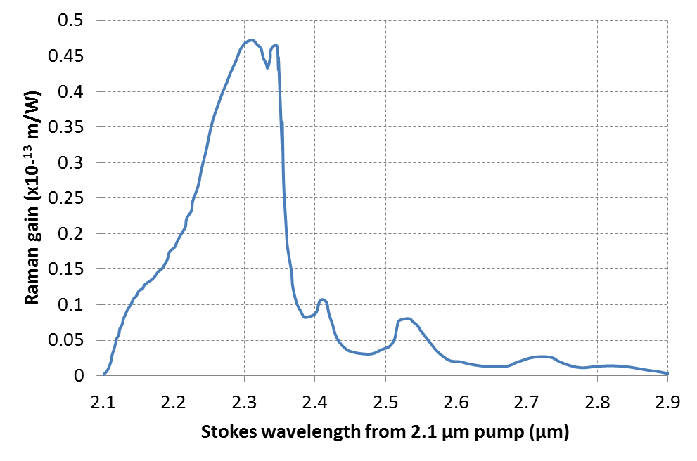
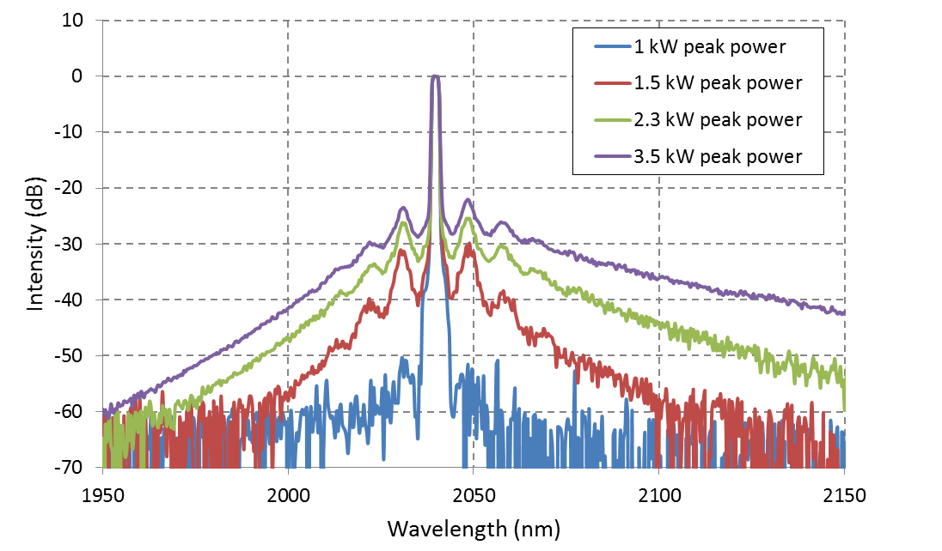
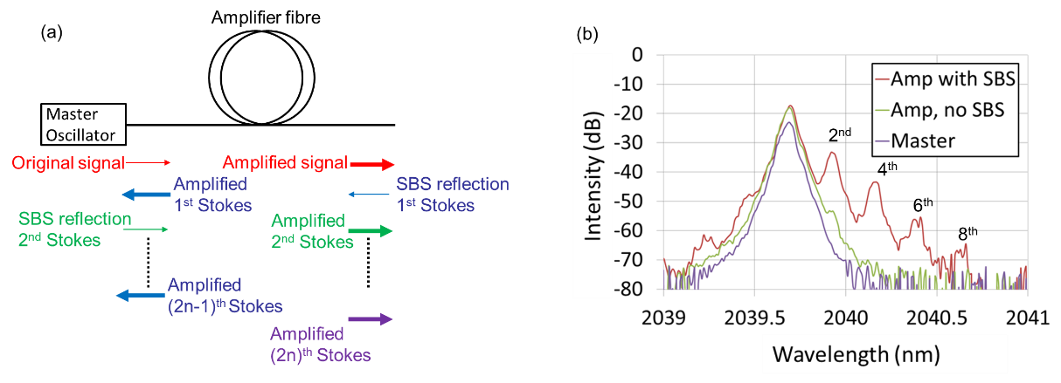
Nonlinear mechanisms

Slide 19
Relative scale
Consider 10 kW peak power (>ns pulse) at 2.1 µm in a fibre with an A_{eff} = 300 μm² (MFD = 20 µm)
Effect | Gain (dB/m) | Comments
MI | 23 | Very little can be done to directly suppress this effect. Peak gain occurs within ±15 nm around signal.
SRS | 6.5 | Assume fibre has OH content of ~1 ppm. Peak gain at 2.3 µm from a 2.1 µm pump
SBS | 72, (7.2)* | 1 GHz, (10 GHz) bandwidth of master oscillator Further inhomogeneous broadening can be used. Peak gain at -8 GHz (0.1 nm) from signal

Slide 20
Power scaling

Slide 21
Power scaling considerations and examples
Double clad geometries
LMA fibre designs
Examples

Slide 22
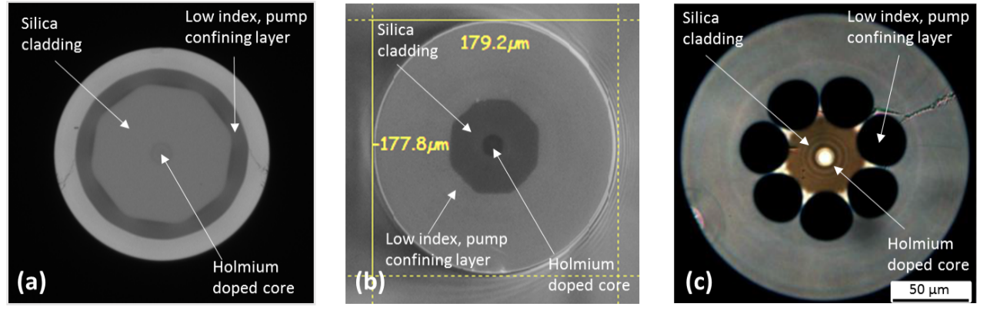
Holmium double clad geometries
Figure 4.5: a) A fluorine layer confines the pump light to an octagon shaped silica cladding of a commercially available holmium-doped fibre [Hemming et al]. b) Holmium-doped fibre fabricated at the University of Southampton with an octagon silica cladding surrounded by a fluorine-doped silica layer. [Shardlow et al] c) An air-jacket design provides pump guidance in a holmium-doped fibre [Ng et al].
A. Hemming, S. Bennetts, N. Simakov, A. Davidson, J. Haub, and A. Carter, "High power operation of cladding pumped holmium-doped silica fibre lasers," Opt. Express 21, 4560 (2013).
S. W. S. Ng, D. G. Lancaster, T. M. Monro, P. C. Henry, and D. J. Ottaway, "Air-Clad Holmium-Doped Silica Fiber Laser," IEEE J. Quantum Electron. 52, 1–8 (2016).

Slide 23
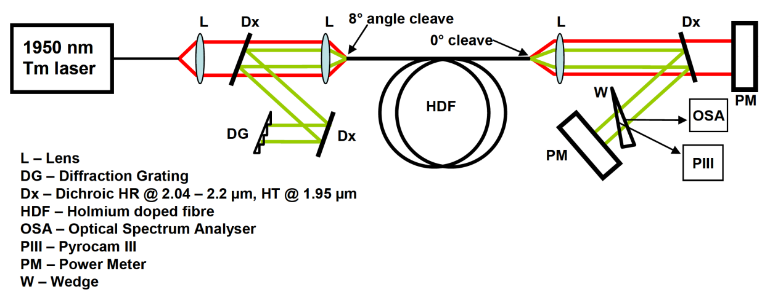
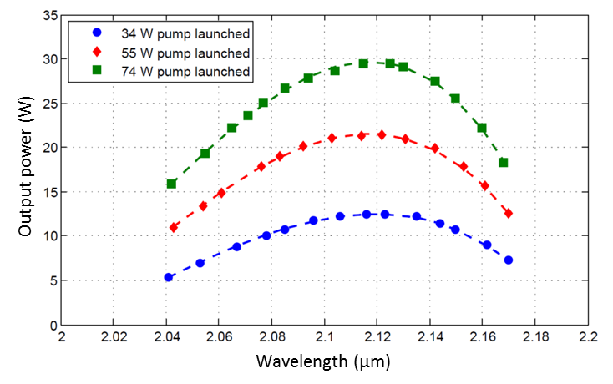
Simple tuning experiments

Slide 24

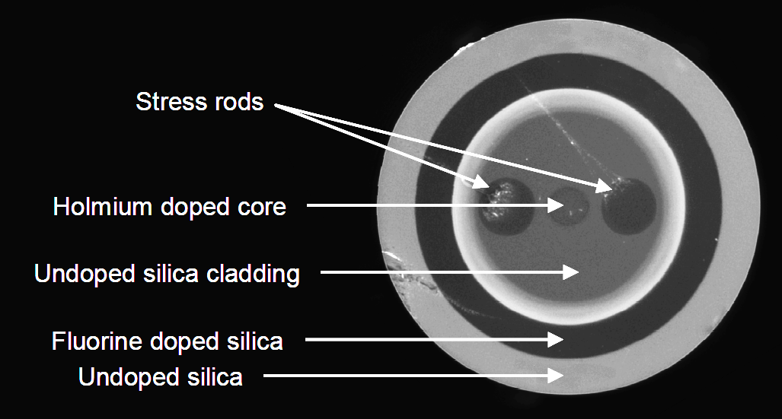
More holmium fibre iterations
Fibre Parameter | Fibre #1 (SM) | Fibre #2 (LMA) | Fibre #3 (PMLMA)
Core diameter | 18 µm | 40 µm | 45 µm
Core NA | 0.08 | 0.08 | 0.075
V-number at 2.1 µm | 2.35 | 4.75 | 5
Power demonstrated | 407 W | 265 W | 45 W (pulsed)
M² | Single mode | 1.3 | 1.6
Inner cladding Diameter | 114 µm | 250 µm | 250 µm
Inner cladding NA | 0.24 | 0.24 | 0.24

Slide 25
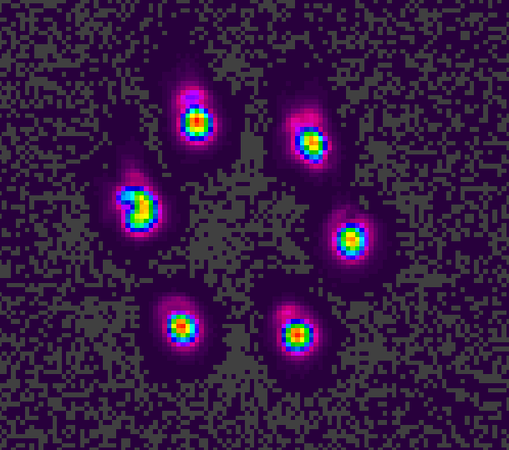
Monolithic pumping solutions
>1 kW of pump launched through a device with very minor heating
  All-glass approach is extremely power scalable
  High brightness pump sources enable ultra low loss components
Outer cladding of combiner

Slide 26
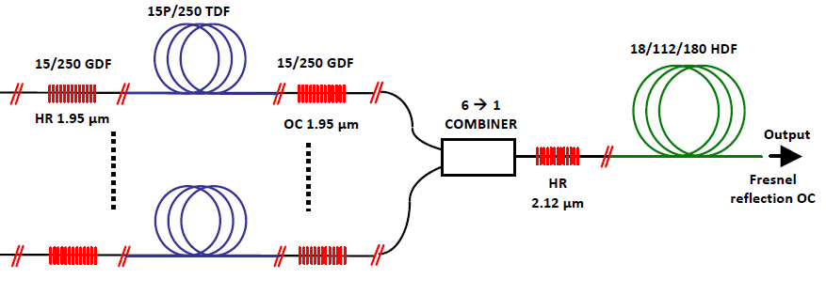
Holmium oscillator power scaling
790 nm laser diode
790 nm laser diode

Slide 27
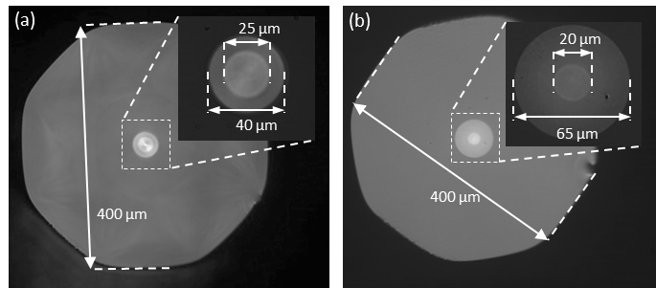
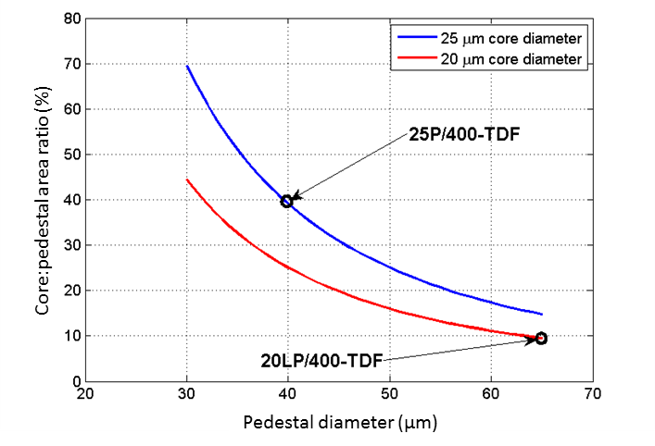
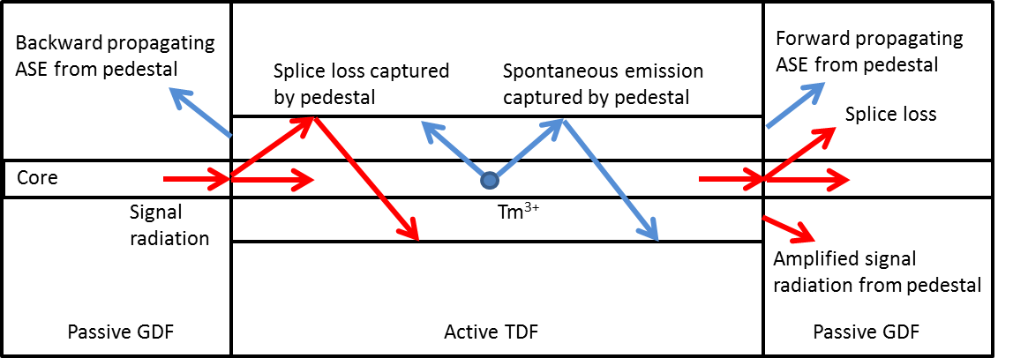
Thulium LMA fibre designs

Slide 28
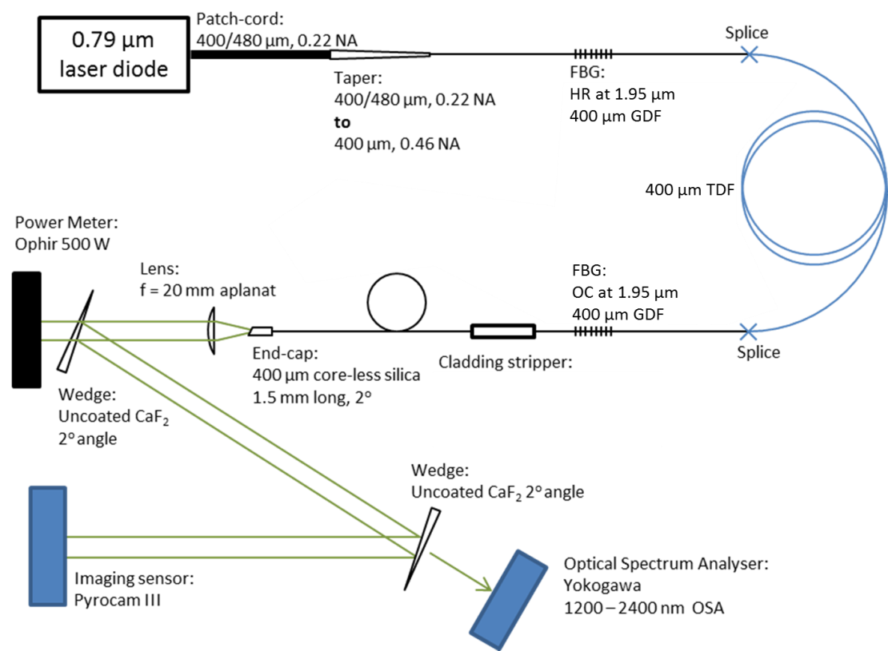
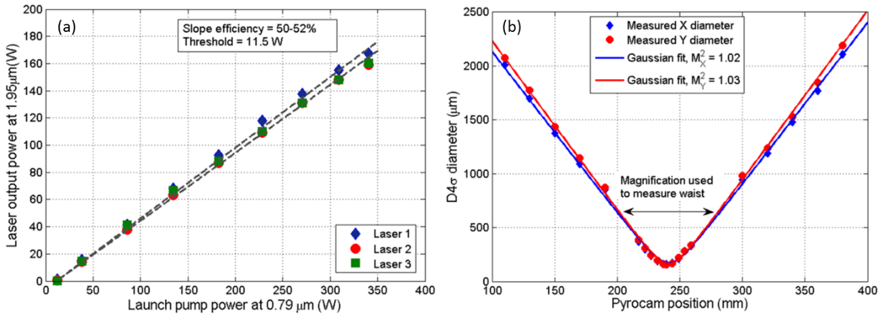
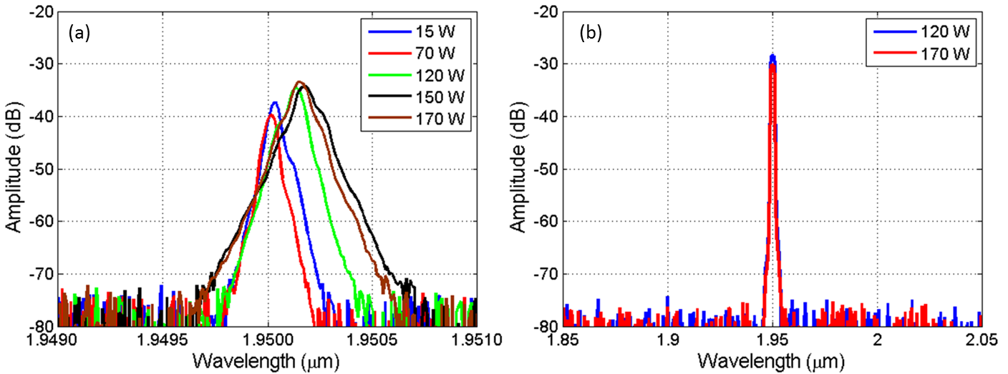
Thulium oscillator power scaling results

Slide 29
Further scaling
(6x) 0.79 µm laser diode
160 W, 200 µm, 0.22 NA
HR (>99.5%) FBG, 1950 nm, 2 nm width
20/400 µm GDF, 0.09/0.46 NA
Reverse propagating power
Splice
6+1 → 1 combiner
Pump: 6x 200 µm, 0.22 NA
Signal: 20/400 µm, GDF 0.09/0.46 NA
6.5 m Large Pedestal TDF
20/65/400 µm, 0.09/0.46 NA
3 m pigtail
Output/forward propagating power
All-glass cladding-light stripper
20/400 µm GDF, 0.09/0.46 NA
10x10x10 mm AR coated infrasil end-cap
OC (R = 5%) FBG, 1950 nm, 0.5 nm width
20/400 µm GDF, 0.09/0.46 NA

Slide 30
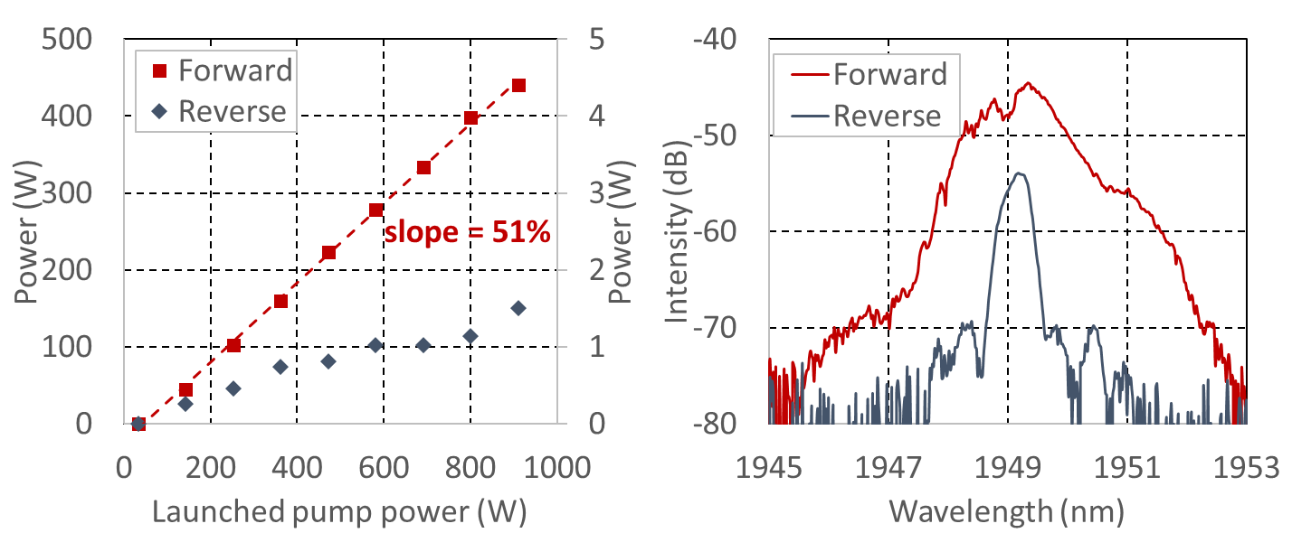
Laser output characteristics

Slide 31
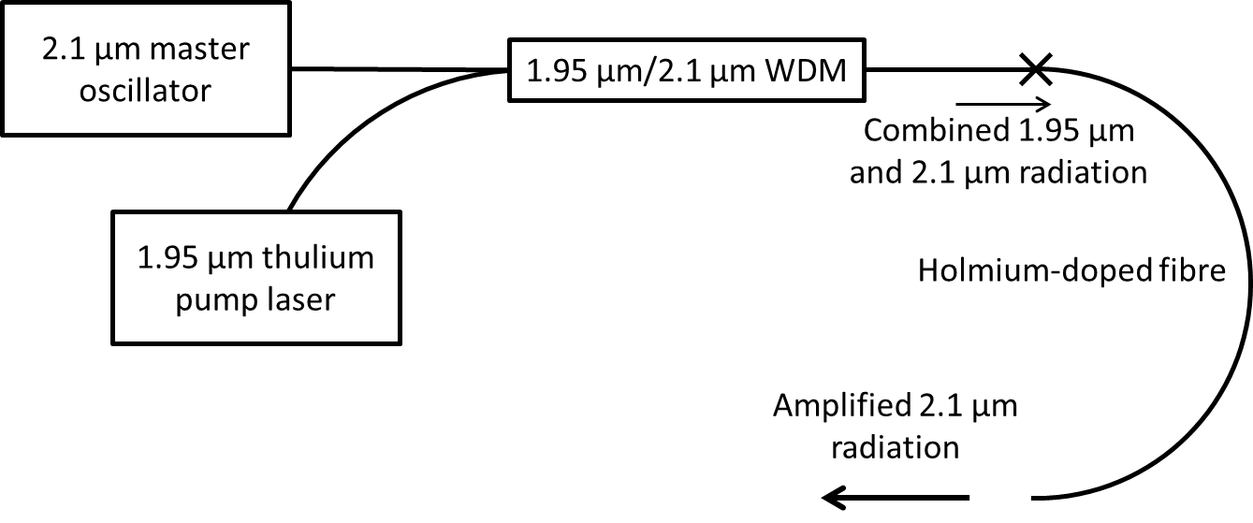
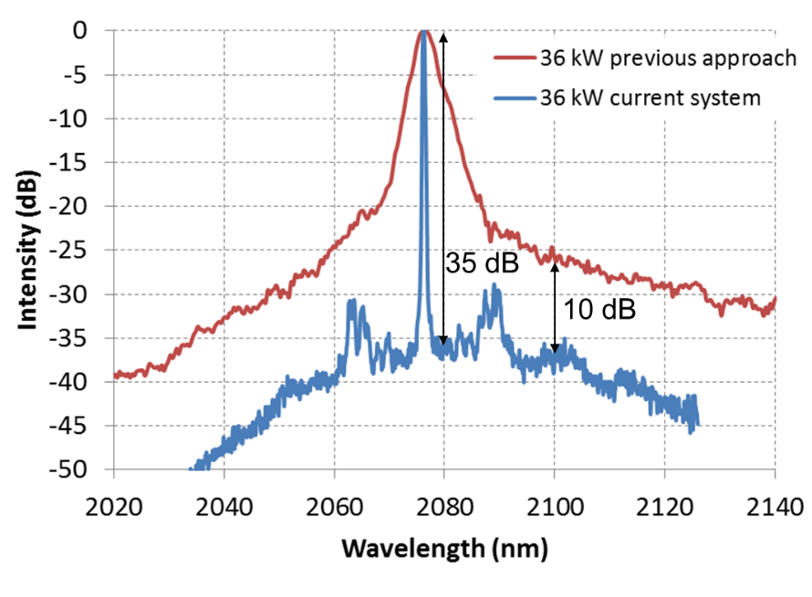
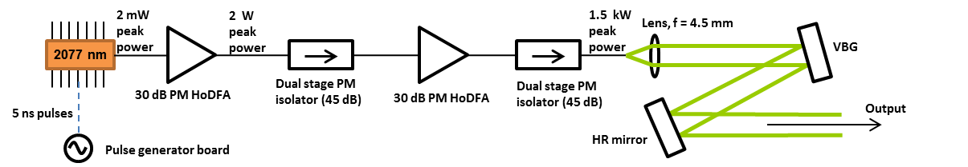
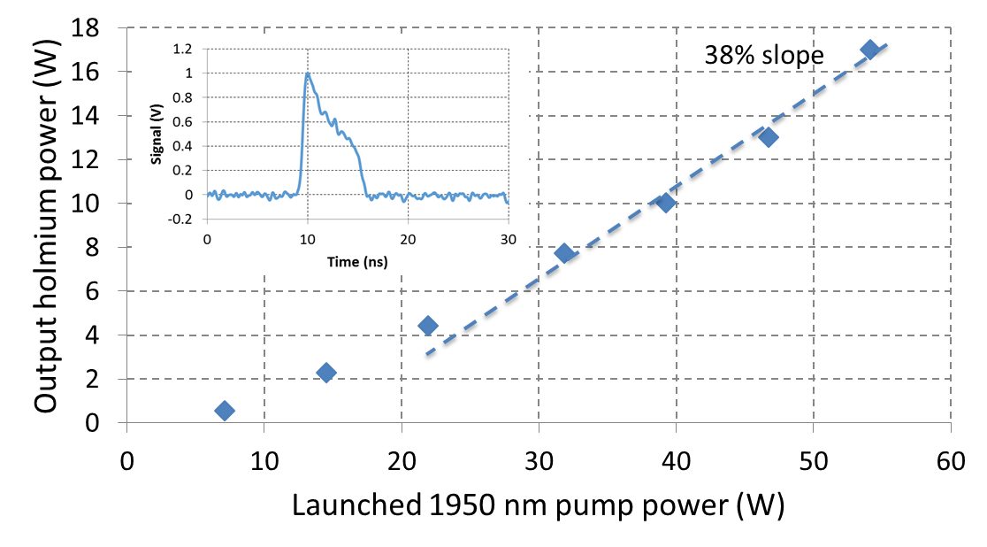
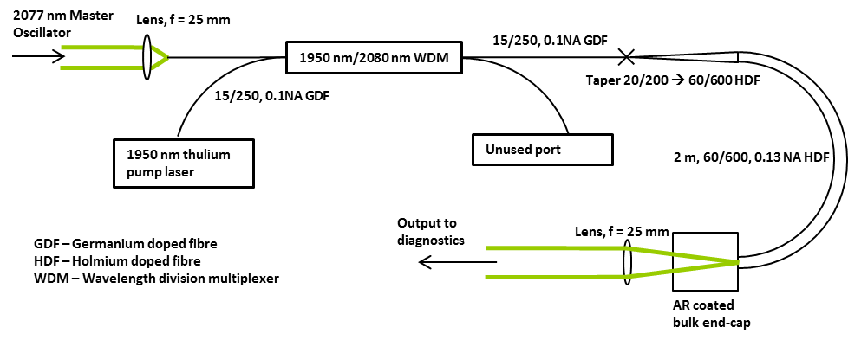
High peak power

Slide 32
Examples of student projects

Slide 33
Components
Master oscillators
  1650 – 2100 nm (Thorlabs, Eblana Photonics, Advalue photonics, other supplies)
Pump sources (core or cladding pumped)
  790 nm diodes (widely available, Thorlabs, nLight, BWT)
  1150 nm diodes (Innolume)
  1550 nm diodes (QPC, Princeton Lightwave, Seminex)
WDM combiners (combining pump and signal radiation)
  Thorlabs, AFR, Gooch and Housego
Isolators
  Thorlabs, AFR, Advalue photonics
Active fibres
  Nufern|Coherent, iXblue, OFS
Passive fibres
  Nufern|Coherent, Thorlabs
FBG components
  Teraxion, iXblue/iXfiber

Slide 34
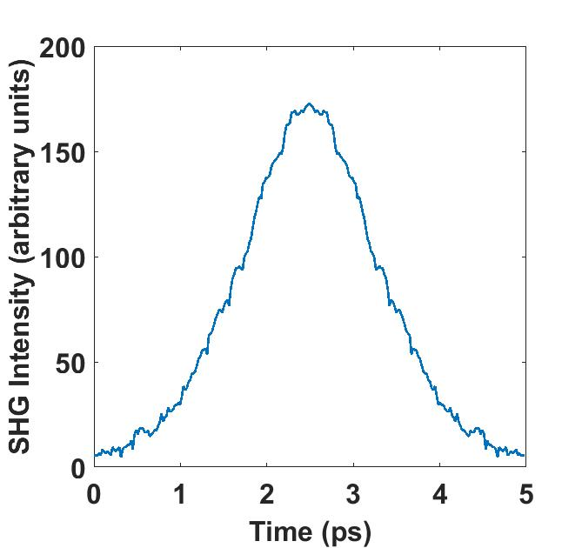
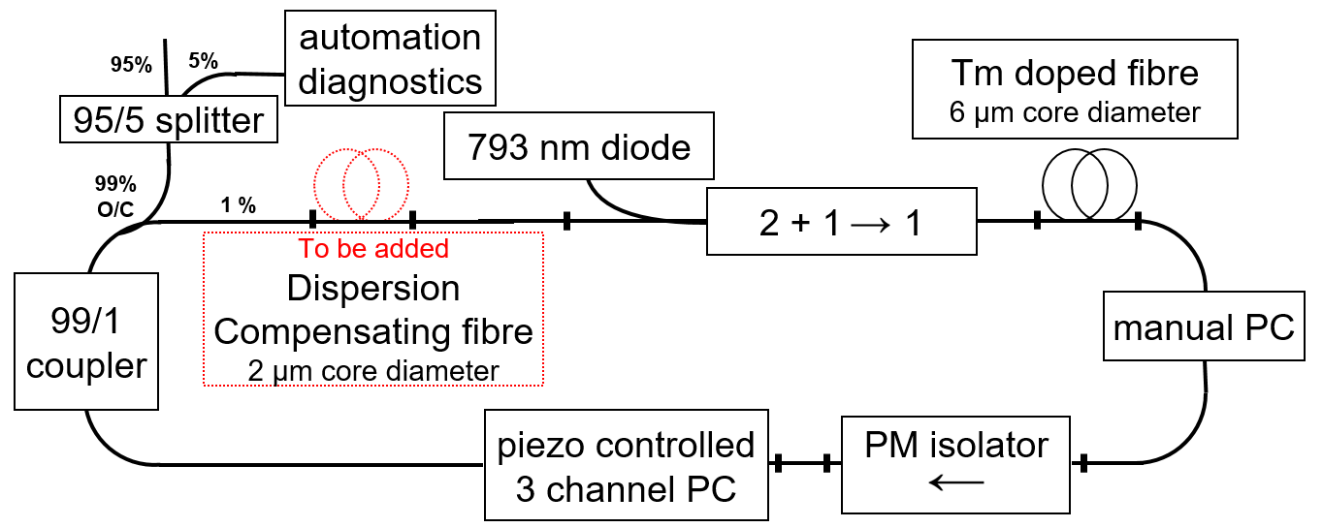
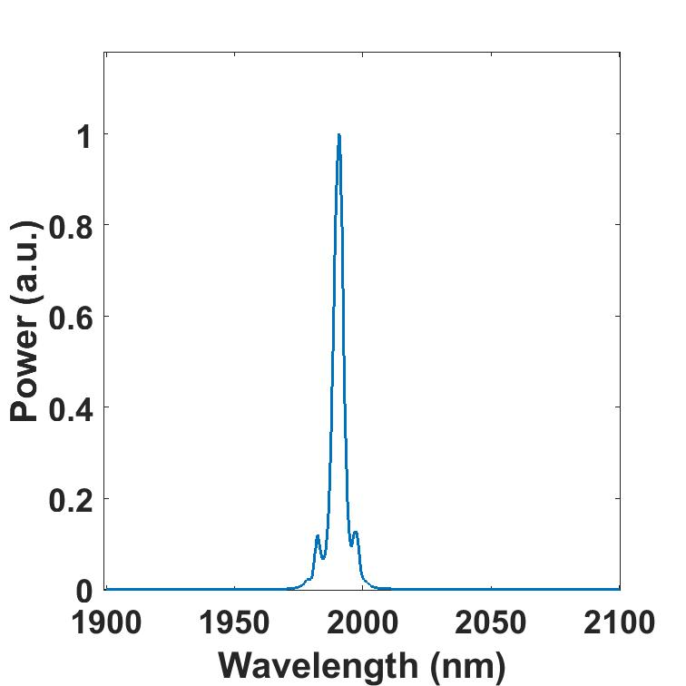
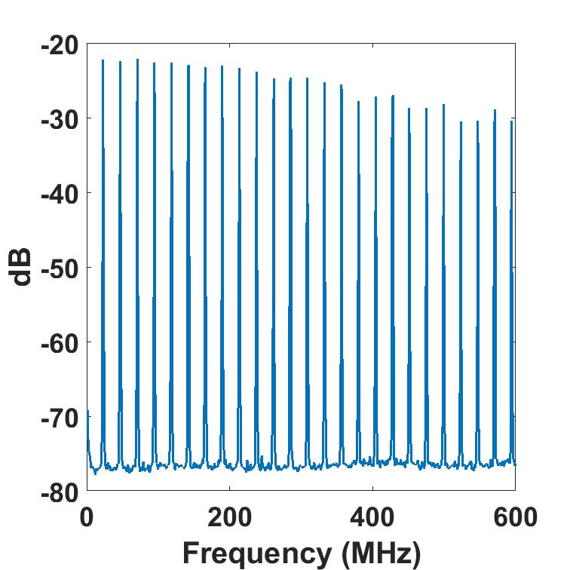


Mode-locked laser development: Thulium
An electronically controlled mode-locked thulium
all-fibre laser at 1.990 µm
David McAfee et al.

Slide 35
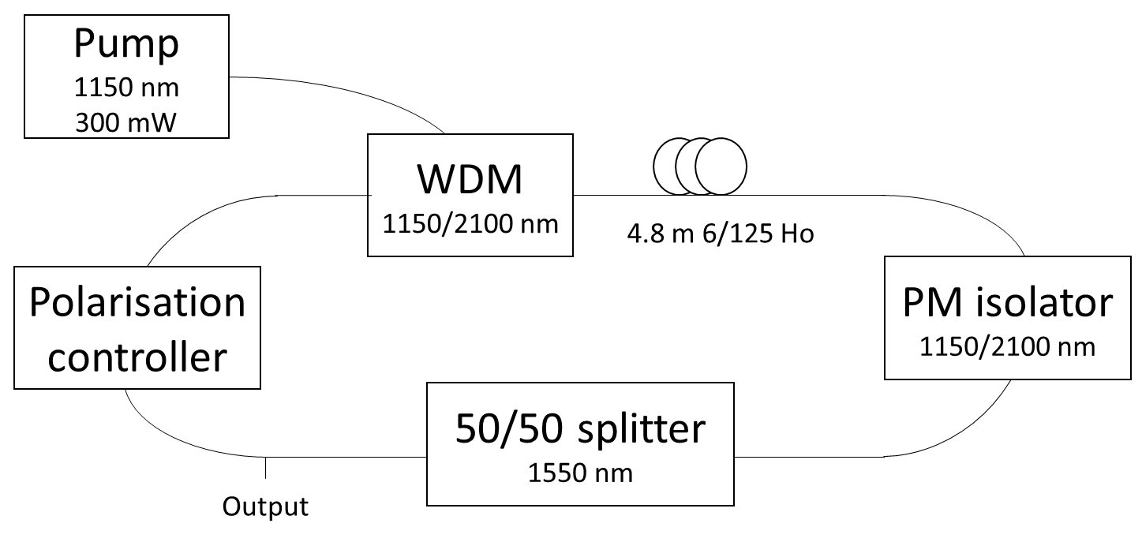
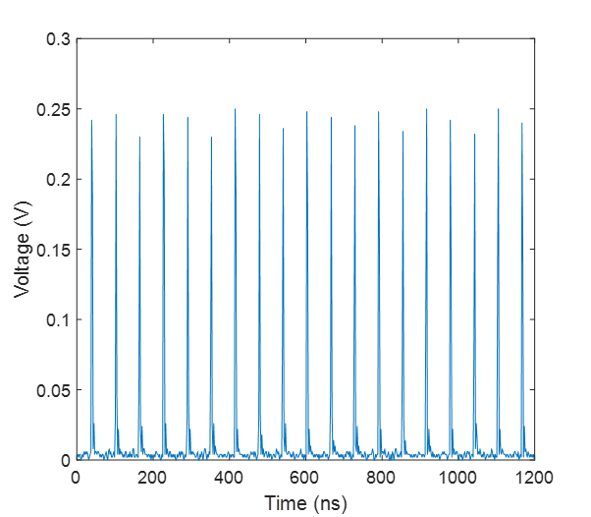
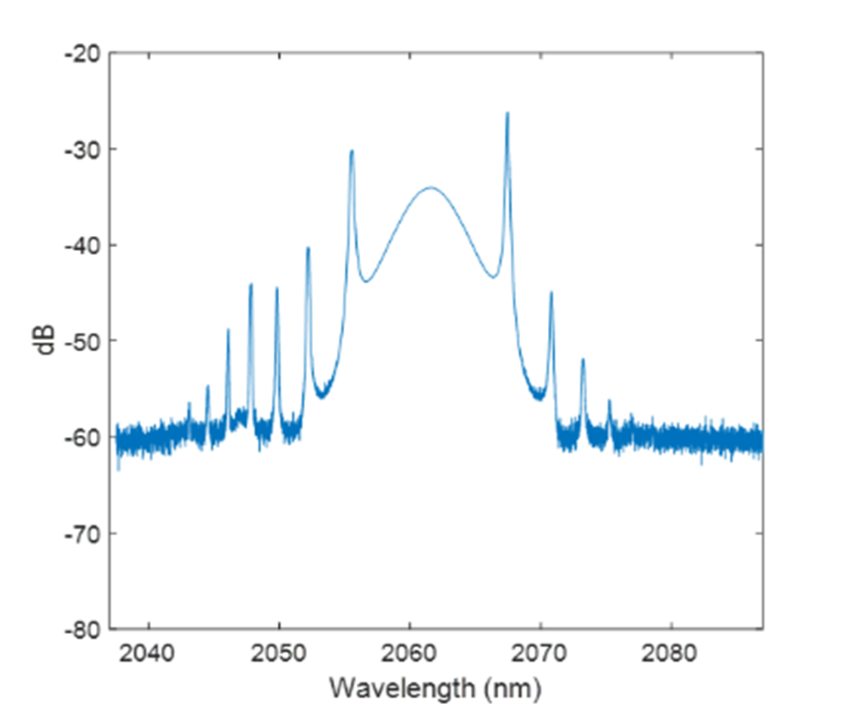
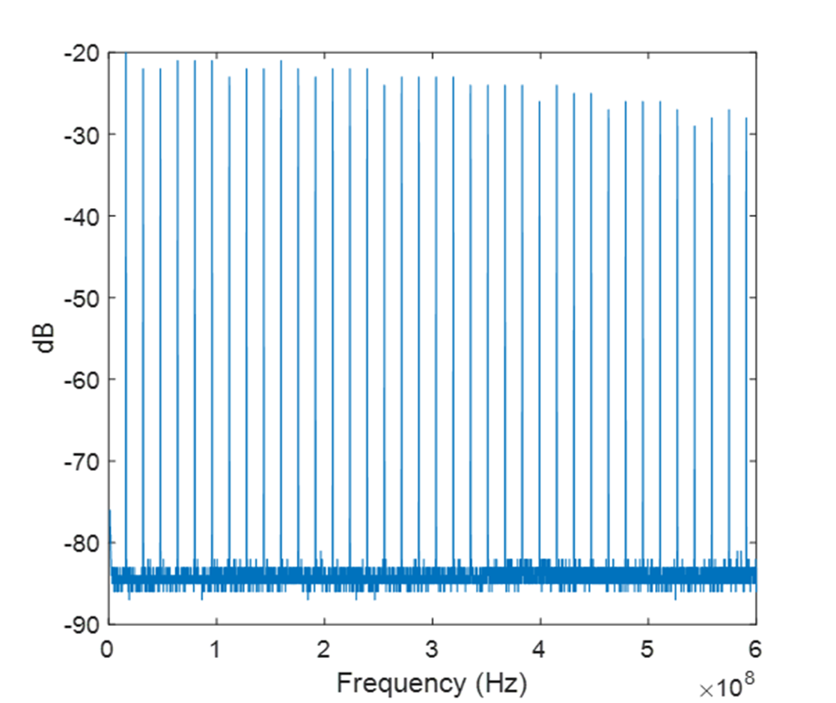
Mode-locked laser development: Holmium
An electronically controlled mode-locked holmium all-fibre laser – recently accepted
David McAfee et al.

Slide 36

Tuneable thulium source
OzGrav are investigating IR and SiOH absorption in bulk fused silica
Required tunable 2 µm source with power level in the order of Watts
Built and delivered diffraction grating tuned source to OzGrav
105/140,
0.22 NA
105/125,
0.22 NA
793 nm laser diode
10/125,
0.16 NA
Combiner
0th order
SMF-28
10/125,
0.16 NA
5.5 m Thulium-doped fibre
Grating normal
FC/APC
6/125,
0.22 NA
SMF-28
1st order
RC
4% Fresnel reflection
Diffraction grating
L
~50 dB
OSA
Wedge
PM = power meter
L = aspheric lens
RC = reflective collimator
OSA = optical spectrum analyser
PM
Student: Adam Gambell

Slide 37
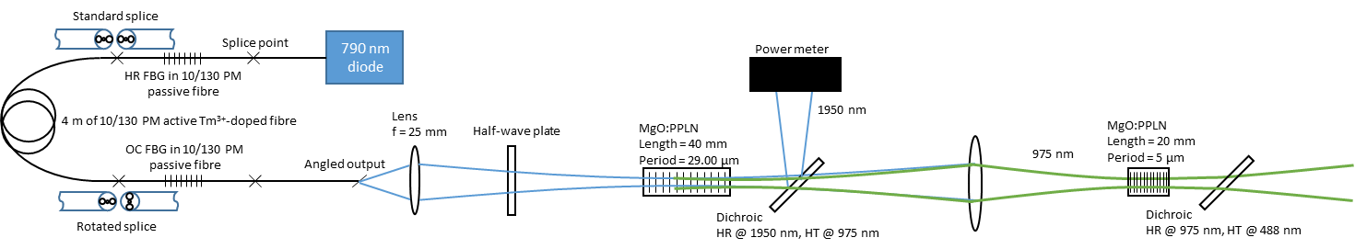
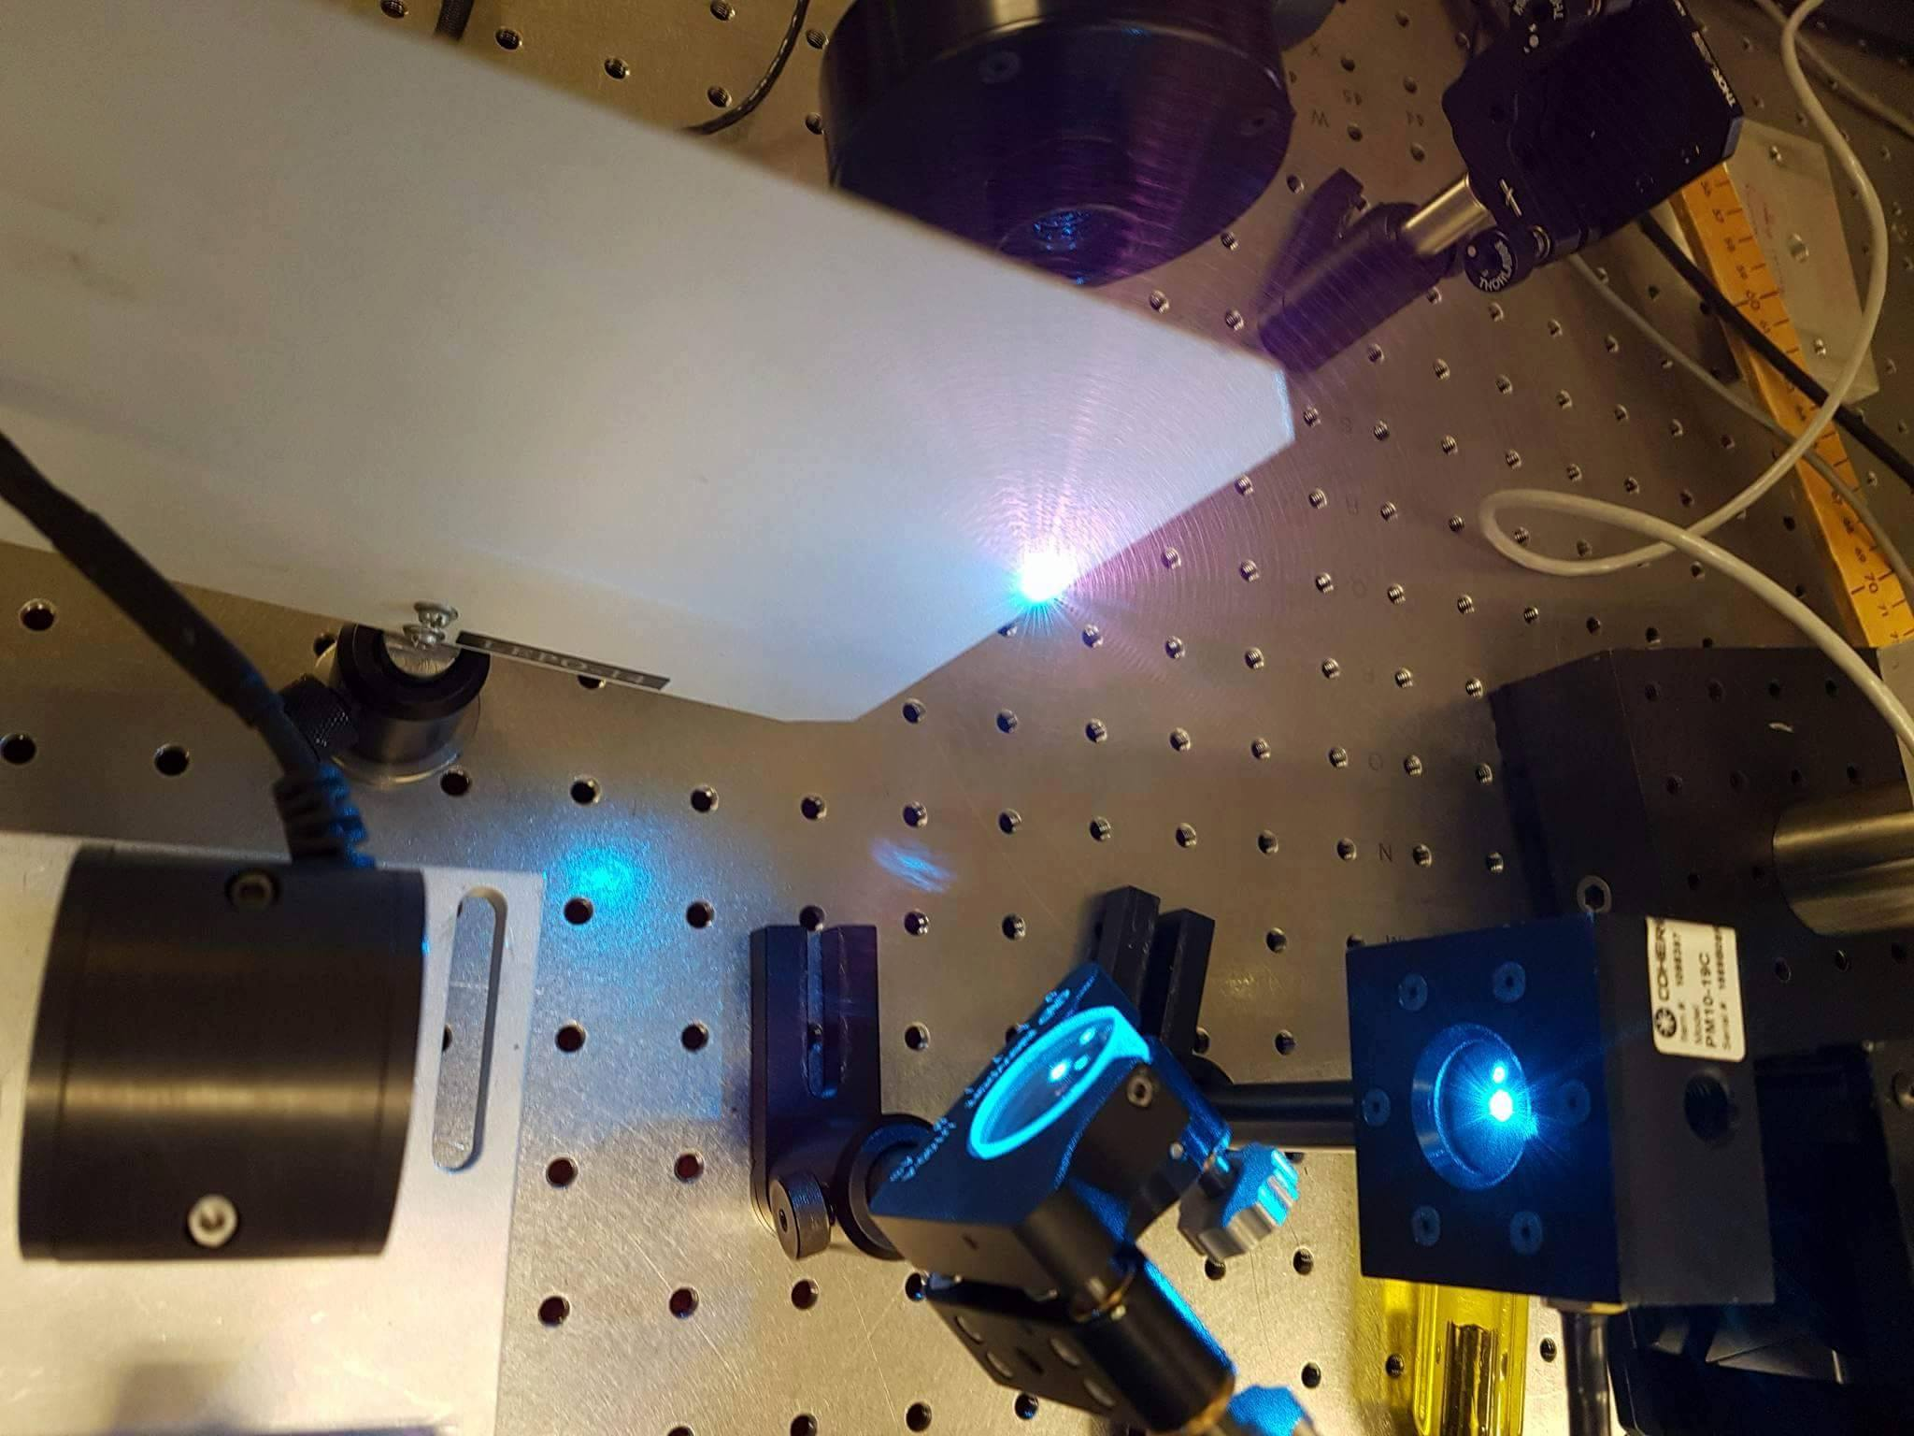
Nonlinear conversion

Slide 38
Additional references
Plenty in the open literature
Papers by Professor Stuart Jackson, Dr. Adrian Carter, Dr. Jas Sanghera, Professor Andrew Clarkson

Slide 39
Thank you for your attention
Questions?

